Slide 1


School of Basic and Applied Sciences
Course Code: BBS01T1002 Course Name: Semiconductor Physics
Direct and indirect band gap semiconductors
Name of the Faculty: Dr. Prabhakar Singh Program Name: B.Tech

Slide 2
Topics to be covered
Direct band gap semiconductor
Indirect semiconductor
Examples of direct and indirect band gap semiconductors
Applications
Practice questions
References

Slide 3
Prerequisite/Recapitulations
--
Knowledge of E-K diagram
Knowledge of Conduction and valence band

Slide 4
Objectives
After the completion of the lecture you will be able to:
Understand the direct and indirect bandgap semiconductors
Explain the difference between direct and indirect bandgap semiconductors
Understand the applications of direct and indirect bandgap semiconductors

Slide 5
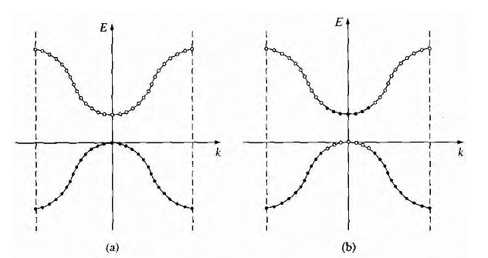
Introduction
E-k diagram
Figure shows the E versus k diagram of the conduction and valence bands for an intrinsic semiconductor at T = 0 K. The energy states in the valence band are completely full and the states in the conduction band are empty. Figure shows these same bands for T > 0 K, in which some electrons have gained enough energy to jump to the conduction band and have left empty states in the valence hand. In absence of any external forces, the electron and "empty state" distributions are symmetrical with k.
The E versus k diagram of the conduction and valence bands of a semiconductor at (a) T = 0 K and (b) T > 0 K.

Slide 6
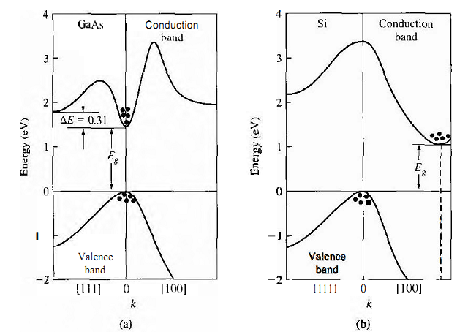
Direct and Indirect band gap Semiconductors
Figure shows the E versus k diagram for Ga-As and Si.
In Ga-As, the valence band maximum and the conduction hand minimum both occur at k = 0. The electrons in the conduction band tend to settle at the minimum conduction band energy which is at k = 0. Similarly, holes in the valence band tend to congregate at the uppermost valence band energy. In Ga-As, the minimum conduction band energy and maximum valence band energy occur at the same k value.
A semiconductor with this property is said to be a direct bandgap semiconductor; transitions between the two allowed bands can take place with no change in crystal momentum. This direct nature has significant effect on the optical properties of the material. Ga-As and other direct bandgap materials are ideally suited for use in semiconductor lasers and other optical devices.
Energy band structures of (a) GaAs and (b) Si

Slide 7
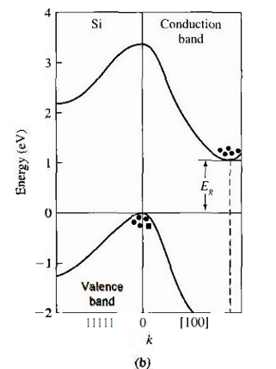
Direct and Indirect band gap Semiconductors
The E versus k diagram for silicon is shown in Figure b. The maximum in the valence band energy occurs at k = 0 as before. The minimum in the conduction band energy occurs not at k = 0, hut along the [100] direction. The difference between the minimum conduction band energy and the maximum valence band energy is still defined as the bandgap energy. A semiconductor whose maximum valence band energy and minimum conduction band energy do not occur at the same k value is called an indirect bandgap semiconductor.
When electrons make a transition between the conduction and valence bands, we must invoke the law of conservation of momentum. A transition in an indirect bandgap material must necessarily include an interaction with the crystal so that crystal momentum is conserved. Germanium is also an indirect bandgap material, whose valence band maximum occurs at k = 0 and whose conduction band minimum occurs along the [111] direction. GaAs is a direct bandgap semiconductor, but other compound semiconductors such as GaP and AlAs, have indirect bandgaps.

Slide 8
Applications of Direct and Indirect band gap Semiconductors
The applications of direct bandgap semiconductors are:
In designing of LED
In designing of Laser Diode

Slide 9
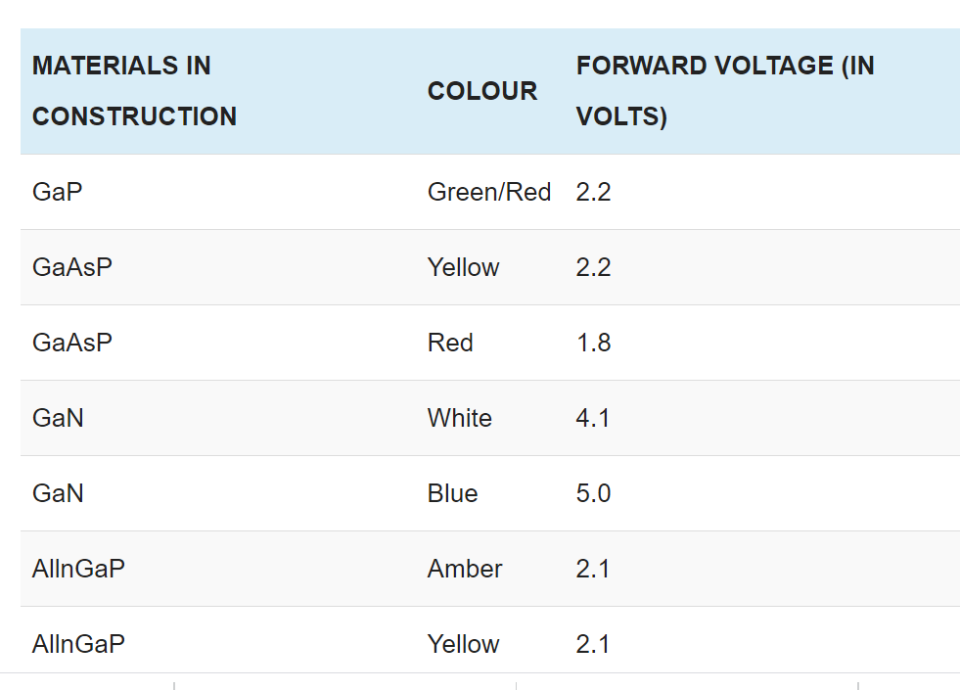
Applications of Direct and Indirect band gap Semiconductors
The wavelength of the light emitted, and hence the color, depends on the band gap energy of the materials forming the p-n junction. The emitted photon energy is approximately equal to the band gap energy of the semiconductor. The following equation relates the wavelength and the energy band gap. hν = Eg , hc/λ = Eg, λ = hc/ Eg
Thus, a semiconductor with a 2 eV band-gap emits light at about 620 nm, in the red. A 3 eV band-gap material would emit at 414 nm, in the violet.
The LEDs realized using two differently doped semiconductors that are the same material is called a homojunction. When they are realized using different bandgap materials they are called a heterostructure device. A heterostructure LED is brighter than a homoJunction LED.

Slide 10
Practice Questions
Draw the E K diagram for direct semiconductors
Draw the E-K diagram for indirect semiconductors
What are the applications of direct bandgap semiconductors
Give the examples of direct and indirect bandgap semiconductors

Slide 11
References:
1. J. Singh , Semiconductor optoelectronics, Physics and Technology, Mc-Graw –Hill Inc. 1995.
2. S.M. Sze, Semiconductor Devices: Physics and Technology, Wiley 2008.
3. Pillai S O, Solid State Physics,( 2010), sixth edition, New Age International (P) Ltd. ISBN-9788122427264.
4. M.N. Avadhanulu and P.G. Kshirsagar, A Text book of Engineering Physics-, 10th
revised Ed, S. Chand & Company Ltd, New Delhi

